Slide 1
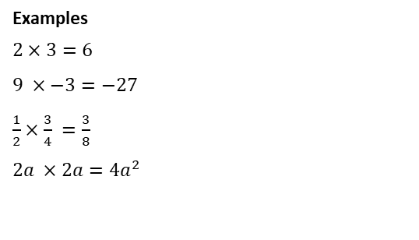
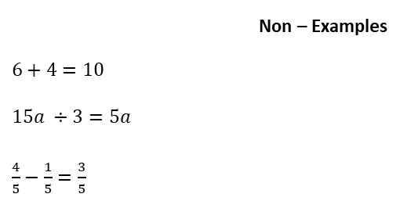
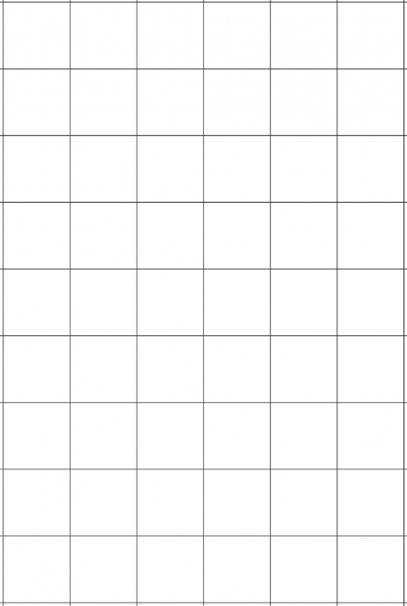
Subtopic N3.5 – Multiplication (with carrying)
LEARNING OUTCOME: To be able to use formal methods to multiply numbers (with carrying)
Objectives:
Keywords:
Multiply
Product
Integer
Digit
To be able to multiply numbers with carrying.
To solve worded problems involving multiplication
Introduction – read and annotate:
You will have already learned the how to multiply using written methods in primary school, and now
we’re going to practise it again to make sure those skills are still strong. It’s important to be confident
with steps like carrying digits and using a placeholder zero when multiplying by the tens column. This
will help you get accurate answers and avoid small mistakes. We’re doing this now to prepare for
multiplying with decimals, where these same skills are just as important.
Definition
The result of multiplying two or more numbers or terms together.
Characteristics
Linked words include times, multiply and factor.
Multiplication does not always make numbers bigger.
Product
Multiplying two-digit numbers by two-digit numbers
Example 1 - I do…
Example 2 – We do…
Example 3 – You do…
Steps | Work out | Find the value of | Evaluate
1) Multiply the ones column of the second number by the ones and tens column of the first number. 2) Multiply the tens column of the second number by the ones and tens column of the first number. | 47 x 24 | 71 x 24 | 38 x 15
1128
1704
570

Slide 2
Independent Practice
1. Work out the following multiplications.
27 x 16 b) 47 x 24 c) 53 x 33
432
1128
1749
d) 64 x 27 e) 85 x 42 f) 67 x 35
1728
3570
2345
g) 76 x 35 h) 76 x 53 i) 67 x 53
2660
4028
3551
j) 57 x 63 k) 57 x 36 l) 75 x 36
3591
2052
2700

Slide 3
m) 75 x 63 n) 95 x 63 o) 85 x 36
4725
5985
3060
Multiplying numbers with 3 or more digits by a two-digit number
Example 4 - I do…
Example 5 – We do…
Example 6 – You do…
Steps | Work out | Find the value of | Evaluate
1) Multiply the ones column of the second number by the ones and tens column of the first number. 2) Multiply the tens column of the second number by the ones and tens column of the first number. | 247 x 24 | 24 x 751 | 638 x 15
5928
18024
9570
Independent Practice
2. Work out the following multiplications.
a) 325 x 15 b) 26 x 245 c) 323 x 37
4875
6370
11951

Slide 4
d) 16 x 502 e) 641 x 28 f) 15 x 425
8032
17948
6375
300 x 15 h) 205 x 26 i) 303 x 30
j) 16 x 106 k) 28 x 604 l) 14 x 105
4500
5330
9090
1696
16912
1470

Slide 5
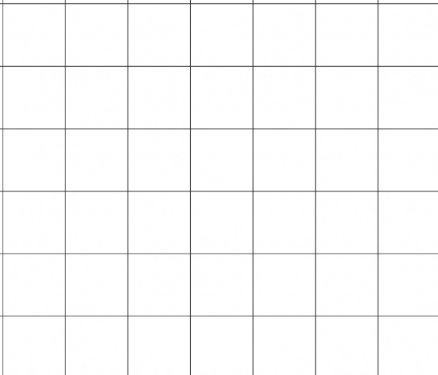
m) 1234 x 16 n) 4321 x 61
o) 9999 x 19 p) 9999 x 91
19744
263581
189981
909909
Solving worded problems involving multiplication.
Example 7 - I do…
Example 8 – We do…
Example 9 – You do…
Steps | A football team brings 8 coaches of supporters to a cup match. Each coach holds 53 passengers. How many supporters are brought to the cup match? | In a lecture theatre there are 12 row of chairs, 37 chairs in each row. How many people can be seated in the lecture theatre? | A photo album contains 28 pages. Each page can hold 6 photos. How many photos can one album hold?
1) Decide what you are multipliying. 2) Carry out the multiplication.
8 x 53
12 x 37
28 x 6
424 supporters
444 people
168 photos

Slide 6
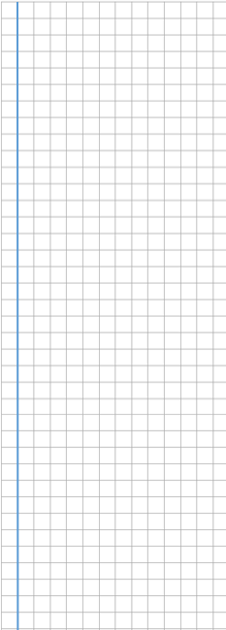
Independent Practice
3. Solve the following problems.
a) A grocer has 37 packs of bananas, Each pack contains 7 bananas. How many bananas are there?
b) Marbles are sold in packs of 25. A shop has 16 bags. How many marbles are there altogether?
c) Envelopes are sold in packs of 14. A supplier has 107 packs. How many envelopes does the supplier have?
d) A library has 105 shelves. Each shelf has 38 books. How many books are there in the library?
e) 24 folders each has 56 sheets of paper inside them. How many sheets of paper are there altogether?
f) There are 226 pencils in a packet. How many pencils are there in 12 such packets?
g) It takes Laura 18 minutes to walk to St John’s School each day. She walked to school and back for 42 days. How many minutes did Laura spend walking to and from school in one week?
h) A theatre has 46 rows. There are 42 seats in each row. During a show at the theatre, there are 50 empty seats. Work out how many people are watching the show.
259 bananas
400 marbles
1498 envelopes
3990 books
1344 sheets
2712 pencils
1512 minutes
1882 people
‹#›

Slide 7
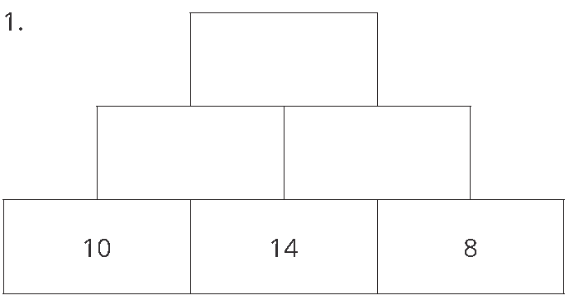
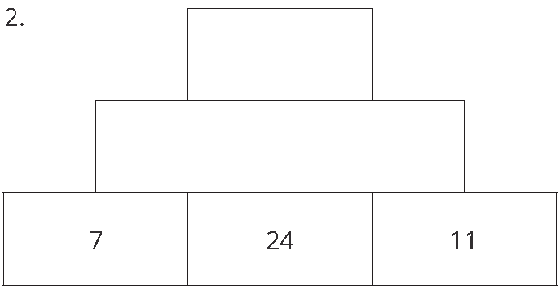
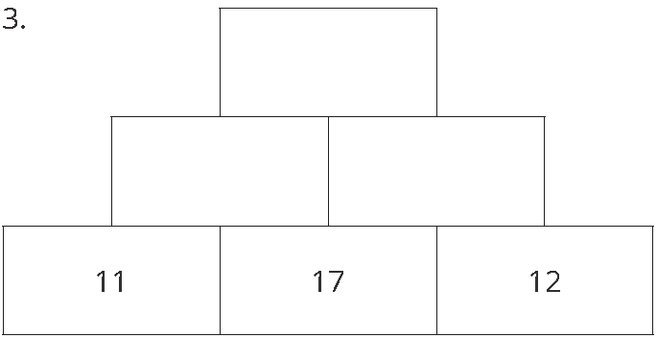
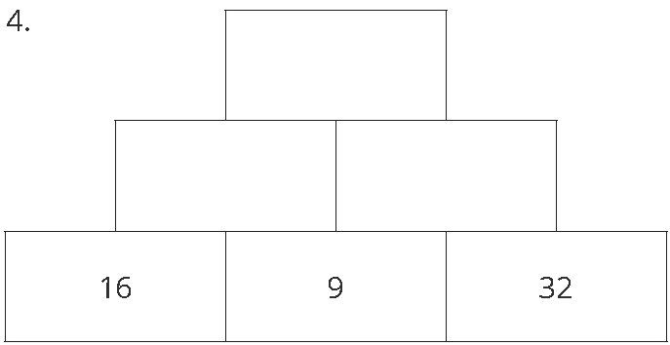
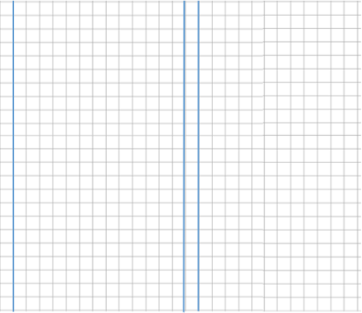
4. Each brick of the pyramid is calculated by finding the product of the two bricks below it.
Find the value of each missing brick.
a)
b)
44352
15680
140
112
168
264
c)
38148
d)
41472
187
204
144
288
5. Work out and choose <, > or = to make the statements correct:
145 x 7 135 x 8
26 x 8 126.8 + 80.1
17 x 13 250 – 42.8
1005 x 7 seven thousand and five
124 x 71 88 x 100
999 x 9 9 x 999
1015 < 1080
208 > 206.9
221 > 207.2
7035 > 7005
8804 > 8800
=

Slide 8
6. Fill in the gaps in the following multiplications.
a)
3 2
4
b)
1 3
7
c)
4 7
×
×
9
×
3
4
9
9 7 2
5 4 8
4 3 1 1
d)
5 3 7
×
e)
6 3 4
×
f)
7 2 5
×
8
9
6
4
2 9
7 0
6
5
6
4
3 5
0
g)
4
7
×
h)
i)
2 7 8
×
3
2 1
3
×
8
7
3
7
7
6
1 4 9
1
8 3
2
4
Skills Check
Work out 28 x 3.
2. Find the product of 128 and 3.
3. Find the value of 47 x 23
4. Timothy saves £34 a month. Calculate how much money Timothy will save in half a year.
168
384
1081
£204

